Slide 1
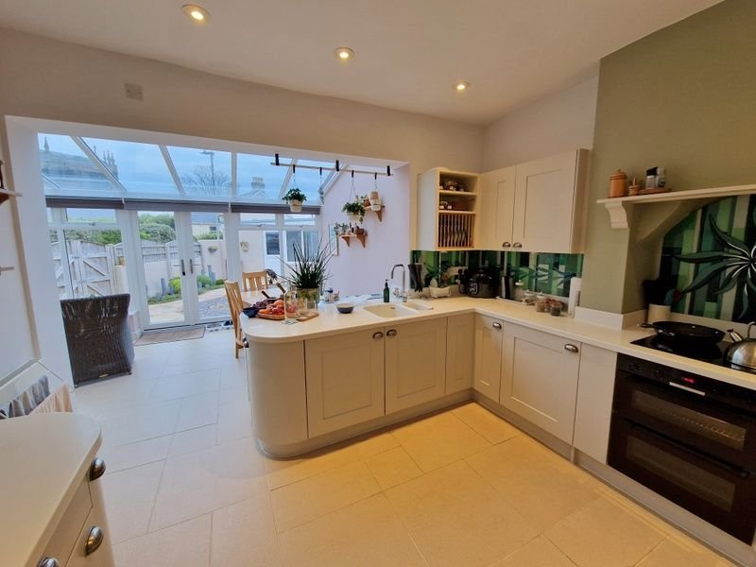
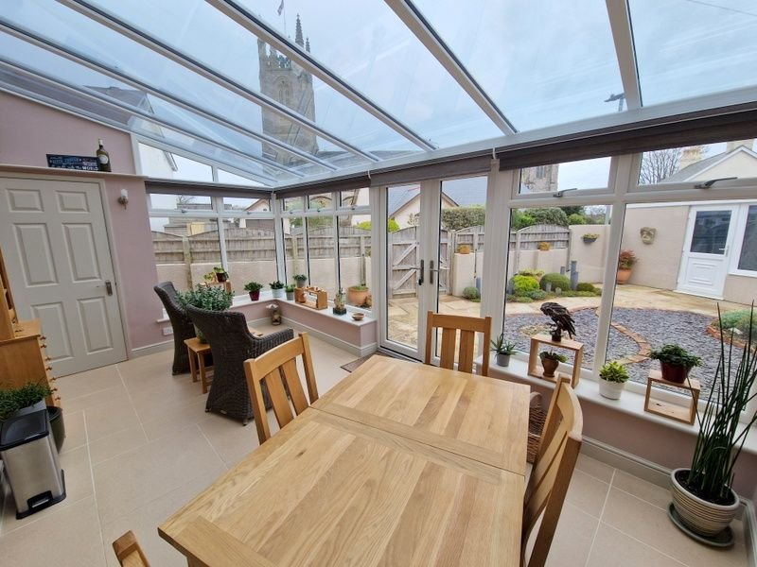
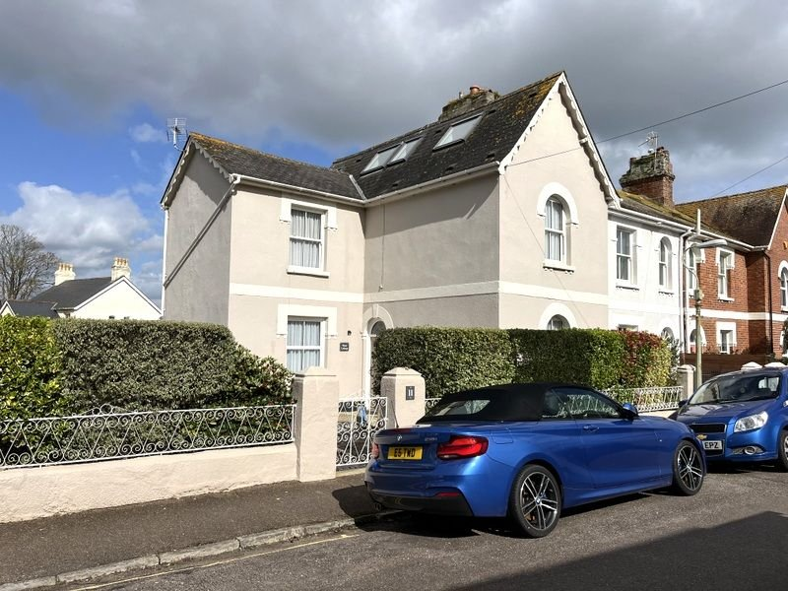
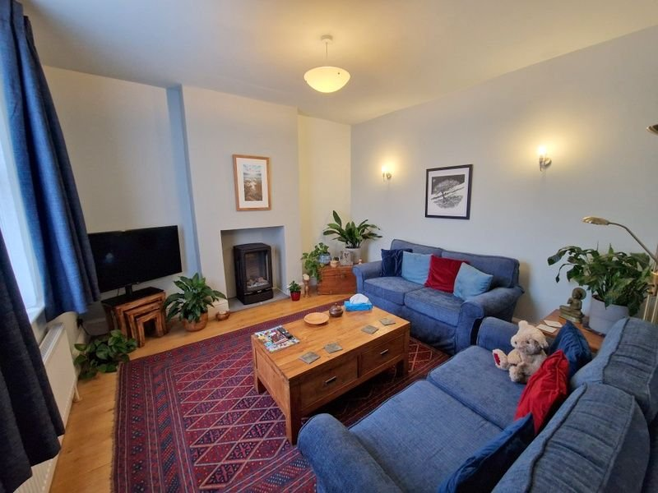
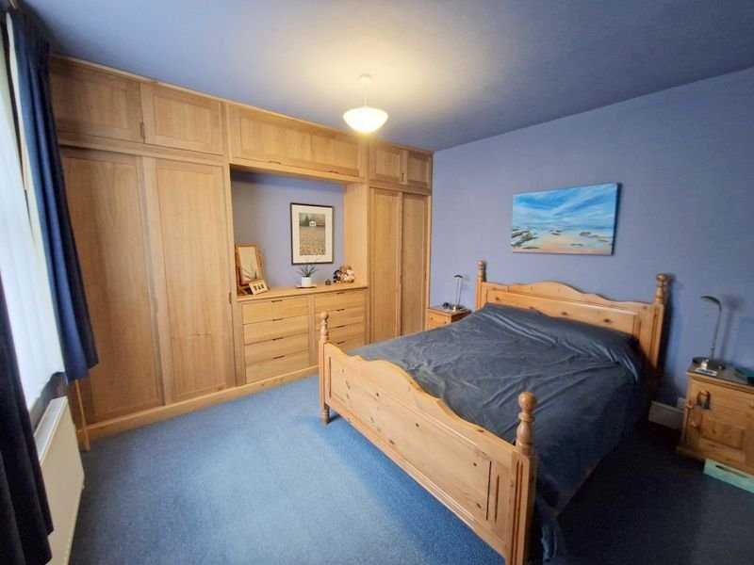
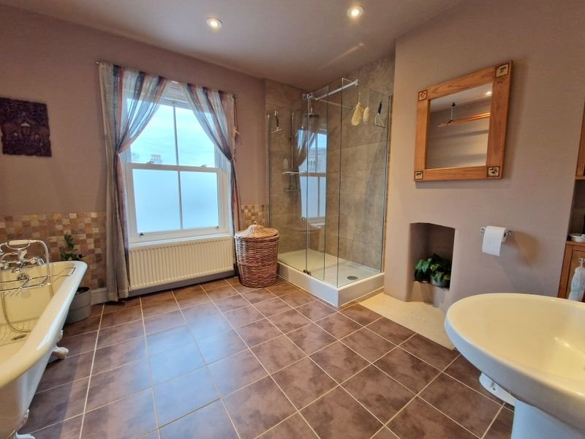
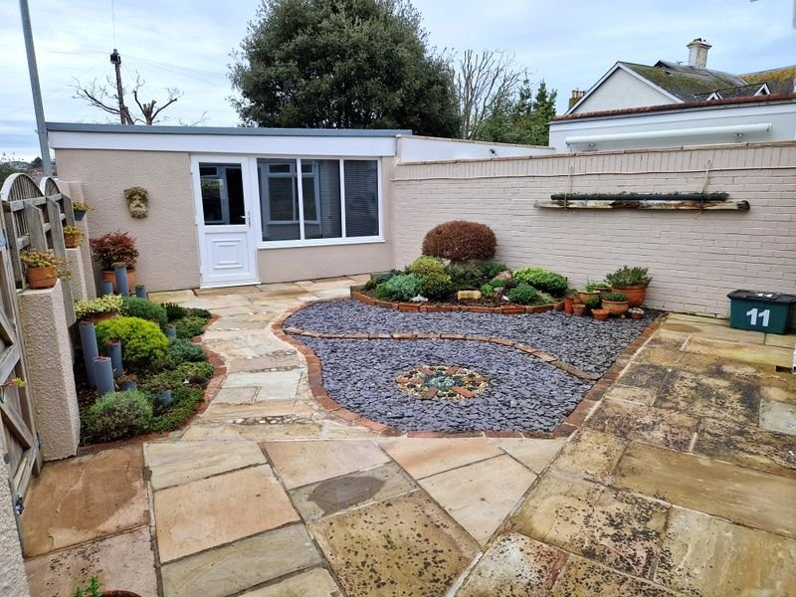
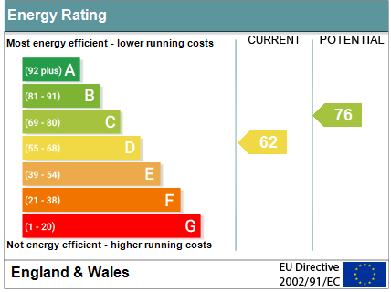
www.pennys.net
Hope Cottage, 11 Beacon Place, Exmouth, EX8 2ST
GUIDE PRICE £625,000
TENURE Freehold
An Elegant Period End Of Terrace House Enjoying An Enviable Location Only A Short Walking Distance Of The Town Centre And Seafront With Attractive Gardens And Large Garage
Stunning Period House • Lounge • Sitting Room • Stylish Modern Kitchen • Conservatory/Dining Room Extension •
Cloakroom/WC • Second Floor Bedroom Suite With Dressing Room & Shower Room/WC •
Well Planned Low Maintenance Gardens • Large Garage • Viewing Recommended •
Pennys Estate Agents Limited for themselves and for the vendor of this property whose agents they are give notice that:- (1) These particulars do not constitute any part of an offer or a contract. (2) All statements contained in these particulars are made without responsibility on the part of Pennys Estate Agents Limited. (3) None of the statements contained in these particulars are to be relied upon as a statement or representation of fact. (4) Any intending purchaser must satisfy himself/herself by inspection or otherwise as to the correctness of each of the statements contained in these particulars. (5) The vendor does not make or give and neither do Pennys Estate Agents Limited nor any person in their employment has any authority to make or give any representation or warranty whatever in relation to this property.
PENNYS ESTATE AGENTS
2 Rolle House, Rolle Street, Exmouth, Devon, EX8 2SN
Tel: 01395 264111 EMail: help@pennys.net

Slide 2
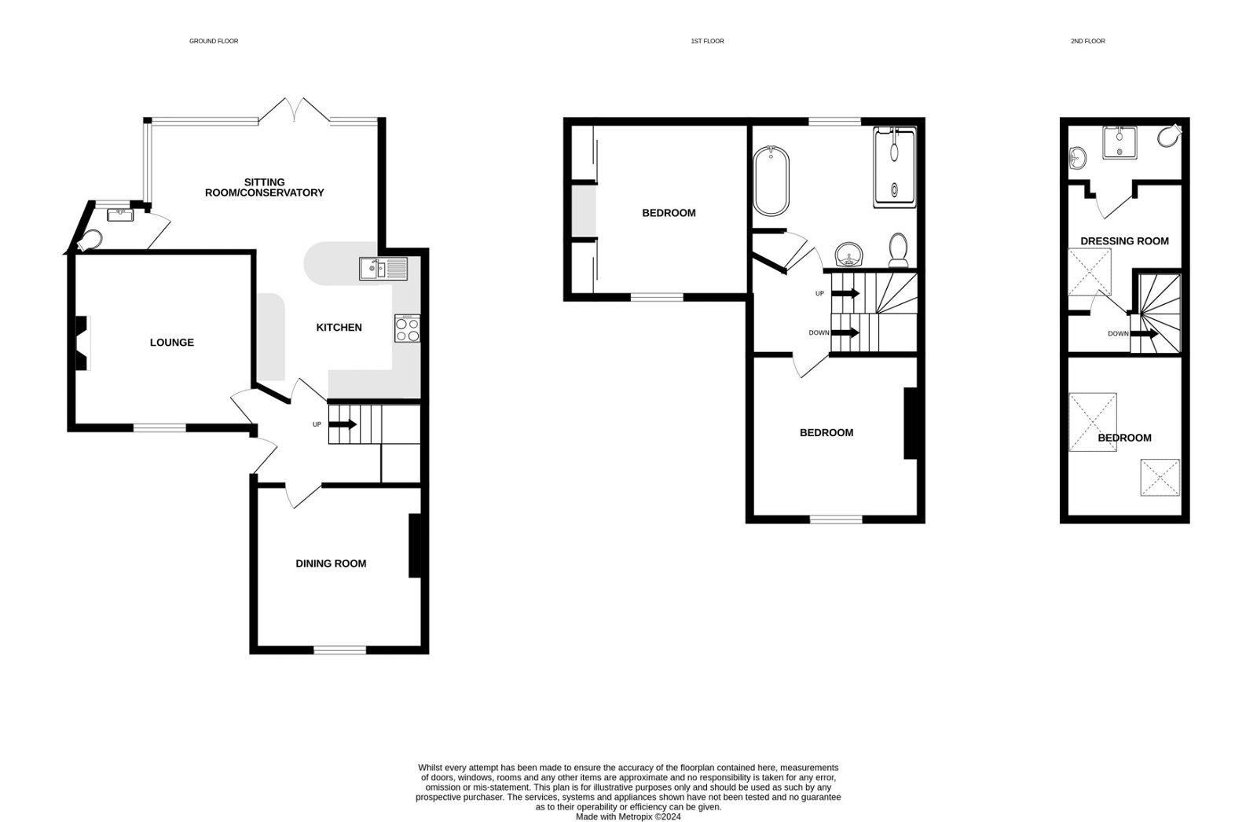
Hope Cottage, 11 Beacon Place, Exmouth, EX8 2ST
THE ACCOMMODATION COMPRISES: Composite front door to: RECEPTION HALL: Engineered oak flooring; radiator; stairs to first floor landing with two accesses to understairs cupboard (housing electric meters and water softener unit) LOUNGE: 3.86m x 3.68m (12'8" x 12'1") A charming room with chimney recess with tiled hearth; television point; radiator; double glazed sash style window to front aspect; engineered oak flooring; wood burner style electric heater. SITTING ROOM: 3.68m x 3.35m (12'1" x 11'0") A versatile room with engineered oak flooring; radiator; double glazed sash window to front aspect. KITCHEN: 3.63m x 3.18m (11'11" x 10'5") A stunning quality room which opens through to the Conservatory/Dining/Sitting Room. Comprising Corian worktop surfaces with integrated one and a quarter bowl sink unit with water filter and integrated drainer and mixer tap; bespoke hand made fused glass splashbacks; range of cupboards and drawer units beneath worktop surfaces; induction hob with oven, light and shelf over; integrated washing machine; space for fridge freezer; wall mounted cupboards incorporating plate rack; recess ceiling LED spotlighting; tiled floor; radiator. CONSERVATORY/DINING/SITTING ROOM: 5.16m x 3.1m (16'11" x 10'2") Double glazed glass roof and windows overlooking rear garden; double glazed double doors to rear garden; tiled floor with underfloor heating; radiator; door to: CLOAKROOM/WC: WC with push button flush; wall mounted gas boiler; tiled floor; space saver wash hand basin with bespoke hand made fused glass splashback; double glazed window with frosted glass. FIRST FLOOR LANDING: Stairs to second floor landing; radiator; doors to: BEDROOM ONE: 3.68m x 3.56m (12'1" x 11'8") Double glazed sash window to front aspect; two quality solid wood built-in wardrobes incorporating chest of drawer units; radiator. BEDROOM TWO: 3.58m x 3.4m (11'9" x 11'2") Double glazed sash window to front aspect; radiator. BATHROOM/WC: 3.63m x 3.2m (11'11" x 10'6") A spacious stylish room with claw-foot free standing bath with shower attachment; double width shower cubicle; pedestal wash hand basin with mirror over with integrated light; WC; built-in cabinets in wall recess; feature chimney recess; attractive tiling to splash prone areas; radiator; double glazed sash window to rear aspect with frosted glass and clear glass affording views to Holy Trinity Church; radiator; tiled floor; floor to ceiling shelved storage cabinet with central display shelf; recess ceiling LED spotlighting. SECOND FLOOR LANDING: Velux window; doors giving access to: BEDROOM THREE SUITE: 3.53m x 2.49m (11'7" x 8'2") Sloping ceiling; two double glazed velux windows and fitted blinds, one with outlook towards Holy Trinity Church; eaves storage space; radiator; LED ceiling spotlighting. DRESSING ROOM: 2.54m x 2.44m (8'4" x 8'0") Double glazed velux window; radiator; with large loft space off; recessed LED ceiling spotlighting; door to:
EN-SUITE SHOWER ROOM/WC: Shower cubicle; wash hand basin; WC with push button flush; tiled floor and walls; double glazed velux window with blind; chrome heated towel rail; tiling to splash prone areas; ceiling extractor fan. OUTSIDE: Pedestrian gate with decorative slate pathway to front door. Attractively planned providing a beach effect pebbled garden, patio seating area, mature hedging with patio side pathway with outside tap to rear garden. The rear garden is attractively planned for low maintenance with patio areas and pathway, decorative flag stone/slate areas and shrub beds, outside power sockets, double wooden side gate to service lane. GARAGE: 6.96m x 4.57m (22'10" x 15'0") (Built in 2018) Electric roller door; power and light connected; two double glazed windows and door to rear garden; shelving and work bench.
FLOOR PLAN:

